Slide 1

Battle of the Neighborhoods –An Analysis of Fitness in San Francisco
An analysis of the most ideal San Francisco Neighborhoods to open a brand-new fitness center.

Slide 2
Introduction
According to US News in 2019, San Francisco was considered the 4th fittest city in the United States.
With the trend of fitness and healthy living, now would be the best time to open a new fitness center. With the intention of opening many more!!
This will be an analysis of each the San Francisco neighborhoods to isolate key locations.

Slide 3
Business Problem
With finding the most optimal locations to open a new fitness center, these are the following questions that will need to be answered.
Using FourSquare API, can we get a visual map of different locations with the nearest venues
From those venues, how many gyms and fitness centers are the the most common in those neighborhoods
Can we conduct an analysis that can isolate neighborhoods?

Slide 4
Data
To conduct this analysis we will be using data from the following locations.
For San Francisco zip code and neighborhood data, we will be using the following url:
http://www.healthysf.org/bdi/outcomes/zipmap.htm
Will use pgeocode package to get latitude and longitude data
Using the Foursquare API, we will gather the following venue data.
Name of Venue
Venue Latitude
Venue Longitude
Venue Category

Slide 5
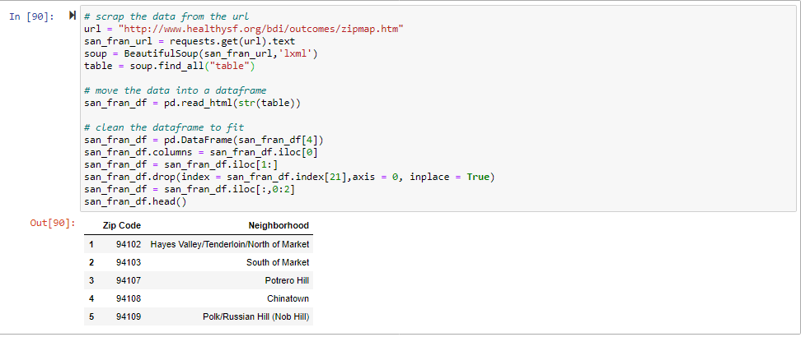
Methodology(Part I)
Data Collection and Cleaning
Using the request package, we begin by scraping the data from the SF ZIP Map (healthysf.org) URL.
From there we read the zip code and neighborhood data into a pandas data frame.
We then clean the data in the data frame to remove and unnecessary data points.

Slide 6
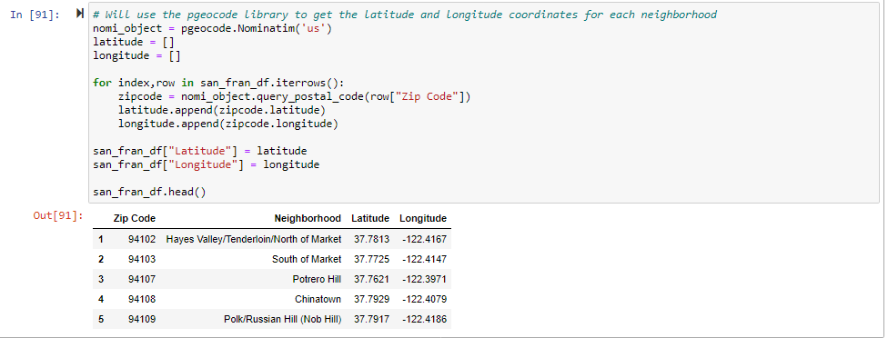
Methodology(Part II)
Pgeocode package
After the data frame has been collected and clean, we use the pgeocode library to start gathering latitude and longitude data.
Once that data is collected, it is added back into the San Francisco data frame.

Slide 7
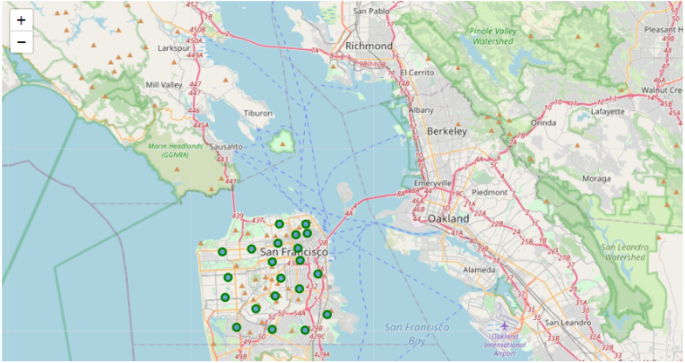
Methodology(Part III)
Visualizing the Data with Folium
With the updated data frame, it can now be mapped.
To do this, we use the Folium package to build a visual map of the data using the latitude and longitude data.

Slide 8
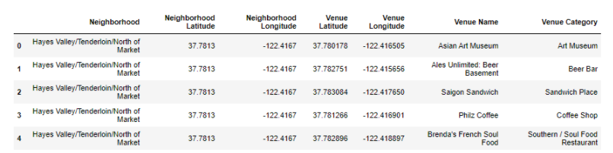
Methodology(Part IV)
Foursquare API
In order to get nearest venue data, we need to use the Foursquare API. This API gathers data regarding the nearest venue to a particular location.
We can use the API to insert a new data frame that includes venue name, venue category, venue latitude and longitude.

Slide 9
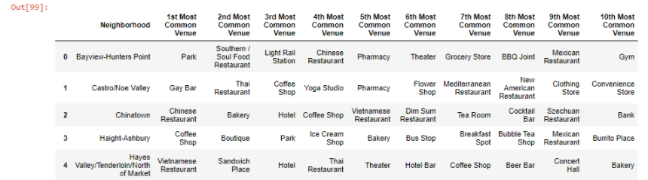
Methodology(Part V)
EDA
After the data frame has been updated, we can begin the explore this data.
First, we take a look at the number of venues in each neighborhood.
Since we have some categorical data, we need to convert it into a numeric value. Using one hot encoding, we can convert each category into a number. This needs to be done to create our model.
Since we need to look at the most common venues, we need to convert the data frame into the frequency of each category and then calculate the most common venues in a particular neighborhood. This data frame will be used to create our model.

Slide 10
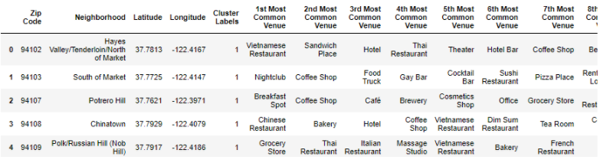
Methodology(Part VI)
Kmean Cluster
Using the calculate most common values data frame, we begin building our data frame.
For the number of clusters we chose 2 clusters as the number of neighborhoods in San Francisco is quite small.
The Cluster labels are then added to the data frame

Slide 11
Methodology(Part VI)
Kmean Cluster
Using the calculate most common values data frame, we begin building our data frame.
For the number of clusters we chose 2 clusters as the number of neighborhoods in San Francisco is quite small.
The Cluster labels are then added to the data frame

Slide 12
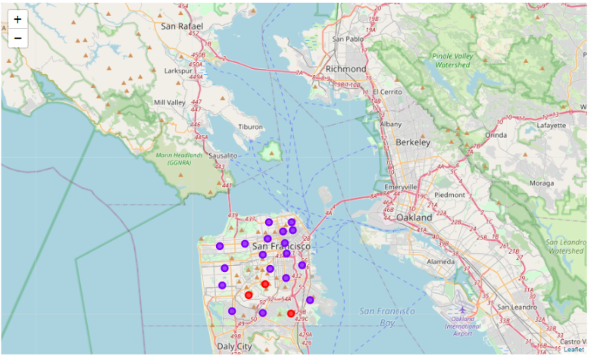
Results
Now that the model is built we can take a visual look at the clusters. We separated each cluster by color.
Cluster 1 is Red
Cluster 2 is Purple

Slide 13
Discussion
By analyzing each of the clusters, we can see each of the characteristics for these particular neighborhoods
For Cluster #1, it is clear that this cluster is mainly for outdoor activities with the higher number of trails and parks.
Cluster #2 seems to be where the higher populations seem to be with more indoor venues such as restaurants, coffee shops and even gyms.

Slide 14
Conclusion
After analyzing the data of the San Francisco neighborhoods, it would appear the cluster #2 would be the ideal locations to open a new fitness center.
Cluster #2 has more accessibility to public transportation and would ideally have more foot traffic that would be a perfect location for a new fitness center!

